Slide 1
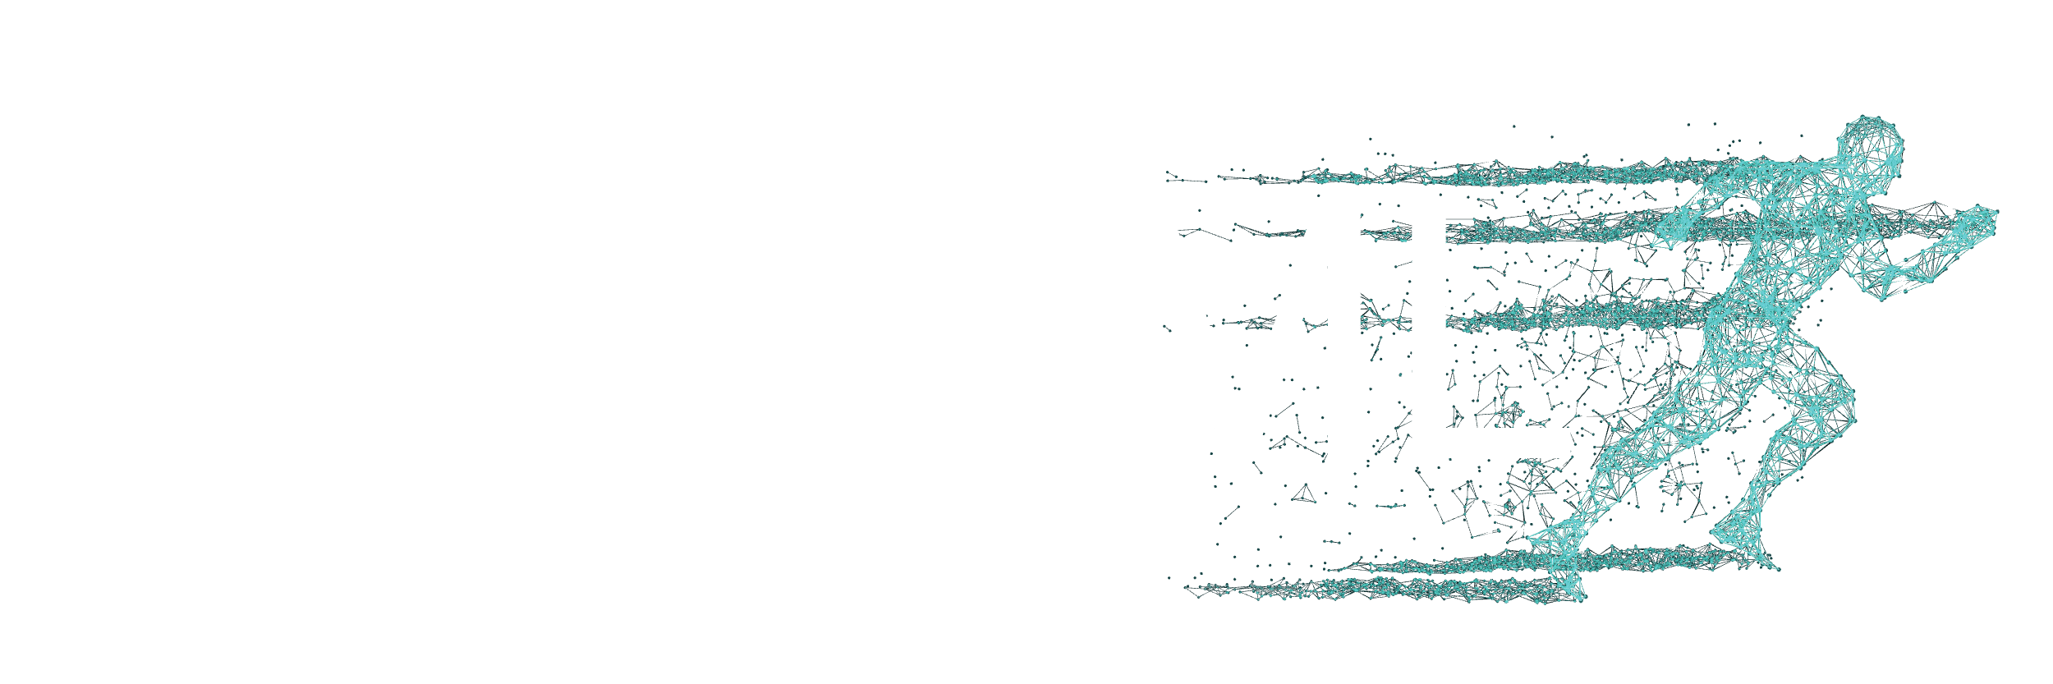

Bucks for Buckets (B4B): Active Defenses Against Stealing Encoders
Jan Dubiński, Stanisław Pawlak, Franziska Boenisch, Tomasz Trzciński, Adam Dziedzic December 15th, 2023
SprintML
Notes:
Hello everyone! Thank you for attending my talk, I really appreciate that. Thank you … for the introduction. My name is Adam Dziedzic and I’m a faculty member at CISPA where I co-lead the SprintML group with Franziska Boenisch. Today, I have the pleasure to present to you our work on stealing and defending machine learning models.

Slide 2
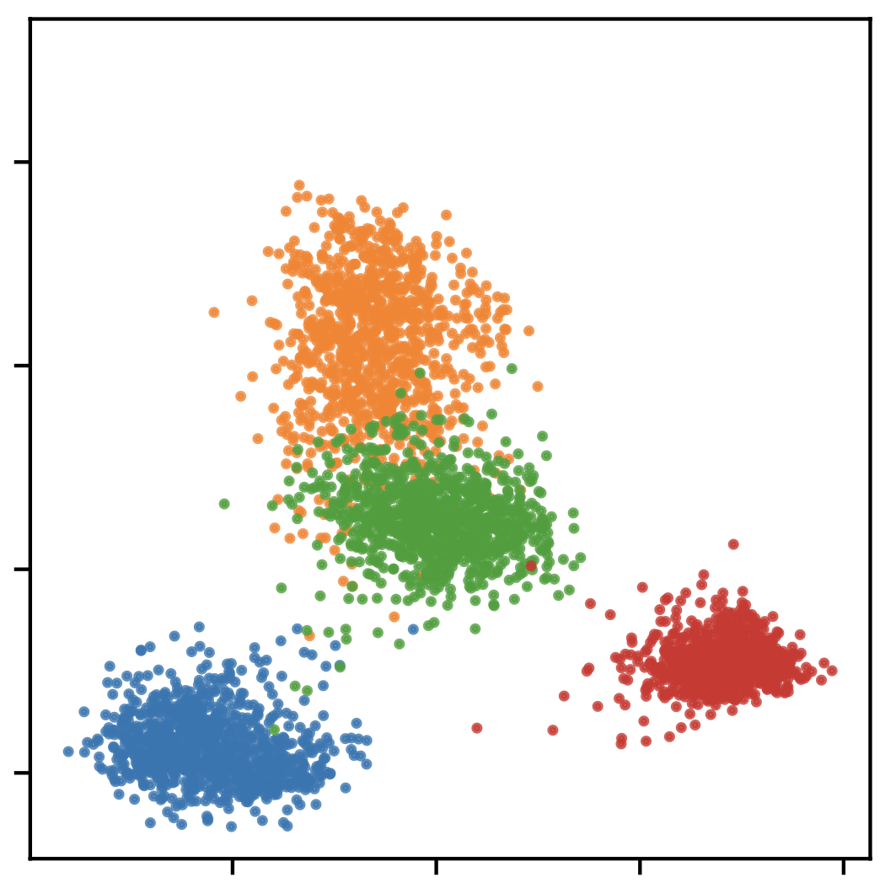
Active Defenses against Stealing SSL Models
LEGITIMATE USERS
SVHN
CIFAR10
STL10
F-MNIST
2
Notes:
How do we design active defenses for SSL models? First, we analyze what is the coverage of the representation space. We observe that for legitimate users, they queries come from a single downstream task, such as CIFAR10 or STL10. However, …

Slide 3

Active Defenses against Stealing SSL Models
LEGITIMATE USERS
ATTACKER
SVHN
SVHN
CIFAR10
CIFAR10
STL10
F-MNIST
F-MNIST
3
Notes:
The adversaries do not want to steal only a subset of the encoder, but its whole functionality. Thus, the representations returned for their queries cover the whole representation space.

Slide 4
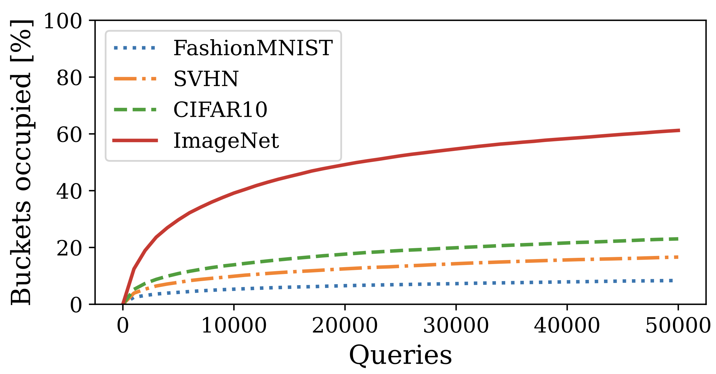
Fraction of Occupied Buckets
4
Notes:
We present the fraction of buckets occupied by representations of different datasets as a function of the number of queries posed to the SSL model. We observe that representations for the downstream datasets (FashionMNIST, SVHN, and CIFAR10) occupy much smaller fraction of buckets than representations from the complex ImageNet dataset.

Slide 5




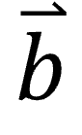
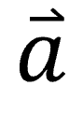
Output Transformations against Sybil Attacks
$$\overset{⃑}{a}$$
$$\overset{⃑}{b}$$
Affine
0.71
-0.25
0.3
…
0.1
-0.25
0.71
0.1
…
0.3
-0.4
Pad+Shuffle
Affine+Pad+Shuffle
Binary
5
Notes:
To prevent adaptive adversaries from eluding our defense by simply creating multiple user accounts (called sybils), B4B also individually transforms each user’s representations. This prevents the adversary from directly aggregating representations over multiple accounts to create their stolen encoder copy. As an example, the pad and shuffle transformation add constant values within representations and shuffle the elements.

Slide 6
Preserve performance for Legitimate Users
Defense | CIFAR10 | STL10 | SVHN | F-MNIST
None | 90.41 | 95.08 | 75.47 | 91.22
B4B | 90.24 | 95.08 | 74.96 | 91.7
6
Notes:
We compare the accuracy of downstream classifiers trained on top of unprotected vs defended encoders. The victim encoder achieves high accuracy on the downstream tasks when no defense is employed. With B4B in place, we observe that across all the downstream tasks, the drop in performance is below 1%.

Slide 7
Lowers Performance for Attackers
Defense | CIFAR10 | STL10 | SVHN | F-MNIST
None | 68.1 | 63.1 | 61.5 | 89.0
B4B | 12.01 | 13.94 | 19.96 | 69.93
7

